Slide 1

Chatbot
Using
Machine Learning
Kevin Mathew T

Slide 2
What is a Chatbot?

Slide 3

Messaging Platforms commonly use Chatbots for advertising products

Slide 4
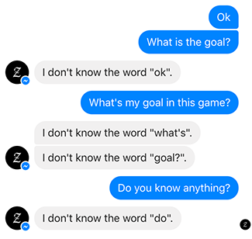
Hardcoded Chatbots
These are chatbots whose behavior is determined by rules.
Conversations with this type of chatbot can only follow predetermined paths. At each step in the conversation the user will need to pick from explicit options to determine the next step in the conversation.

Slide 5
Neural Networks
Many academic papers have come out each with varying degrees of success.
Development is limited to academics since coding Neural Networks is very complex.

Slide 6
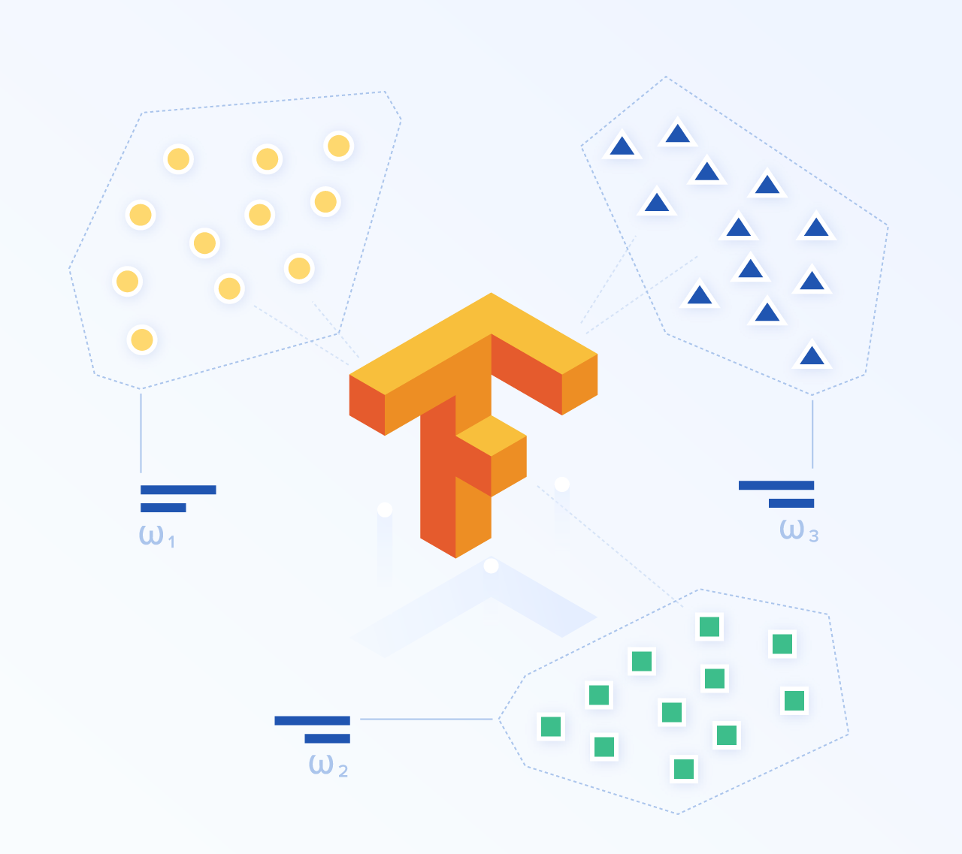

Slide 7
Seq2Seq model with Embedding and Attention Mechanism

Slide 8
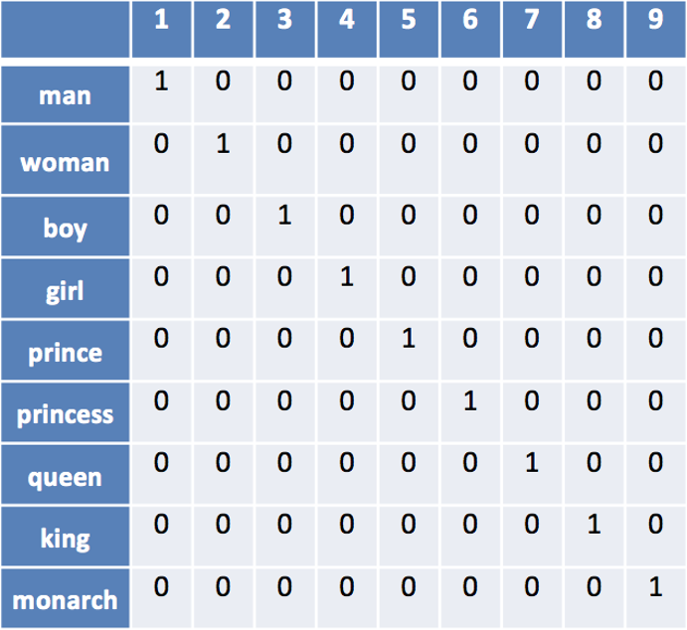
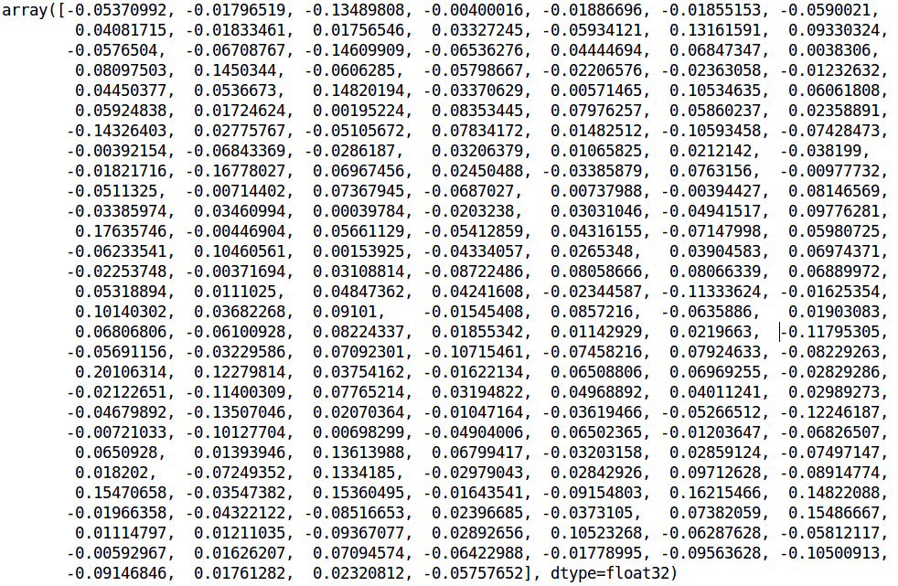
Word Embeddings
Basic Seq2Seq models use one-hot-vectors to represent words.
A word embedding is a vector of fixed size which represents the meaning of a word.

Slide 9
Why Recurrent Neural Networks?

Slide 10
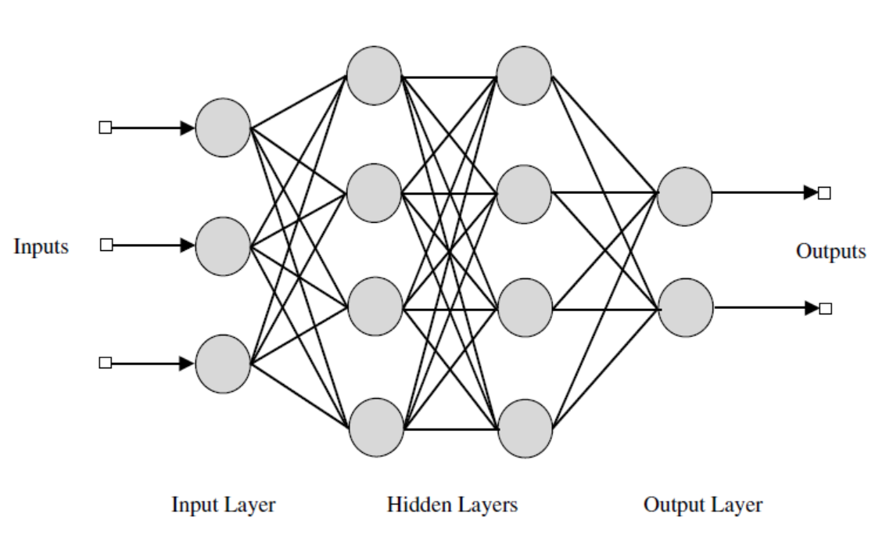
Conditional Memory
Straight - “The quick brown fox jumps over the lazy dog”
Reverse - “Dog lazy the over jumps fox brown quick the”
Feed Forward Neural Networks do not have memory, while Recurrent Neural Networks do.

Slide 11

Recurrent Neural Networks

Slide 12
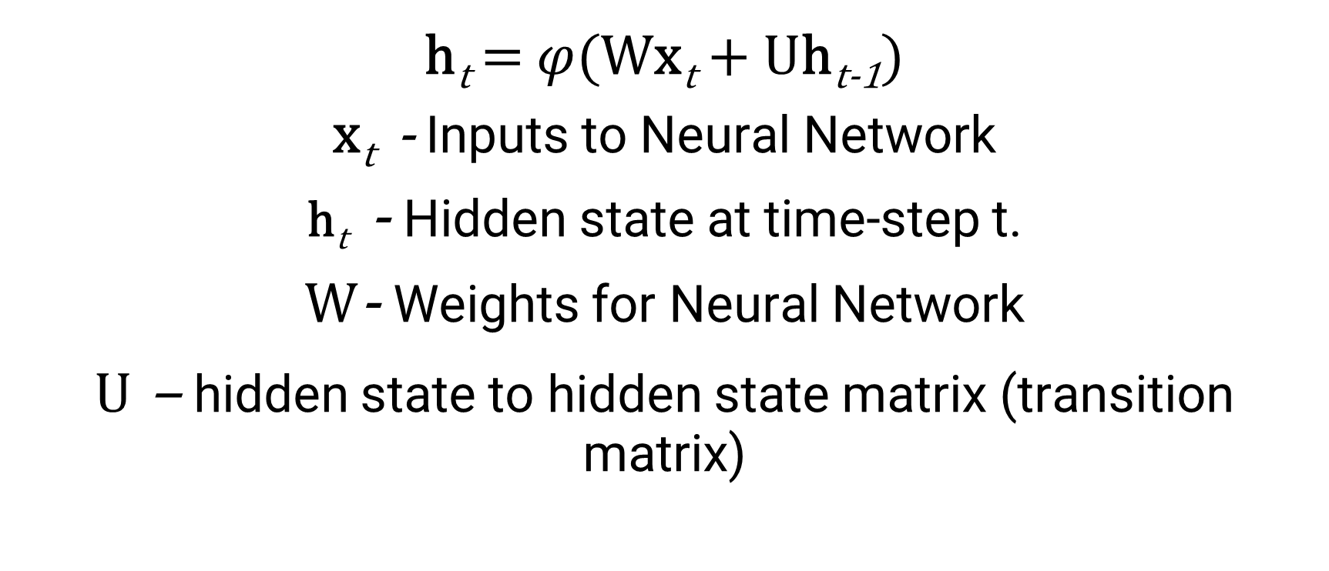
h_{t} = $φ$(Wx_{t} + Uh_{t-1})
x_{t} - Inputs to Neural Network
h_{t} - Hidden state at time-step t.
W- Weights for Neural Network
U – hidden state to hidden state matrix (transition matrix)

Slide 13
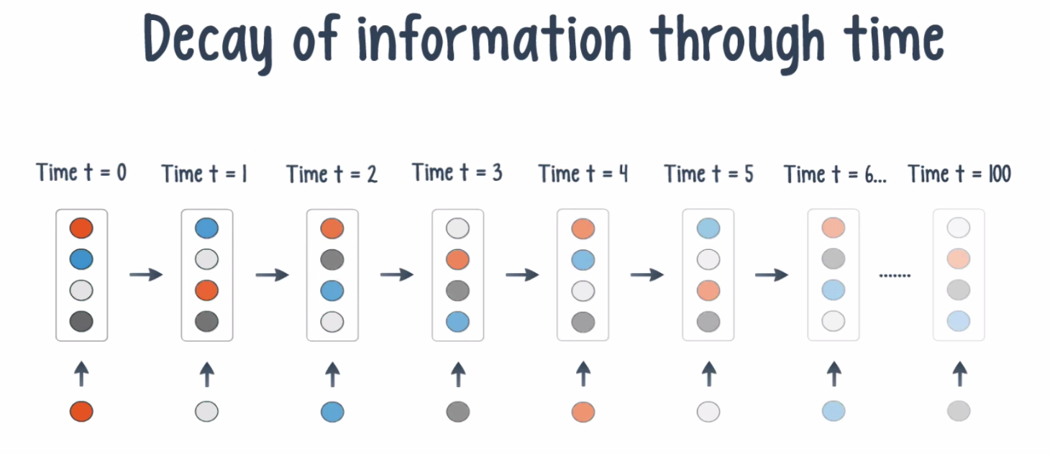
Decay of Information through time

Slide 14
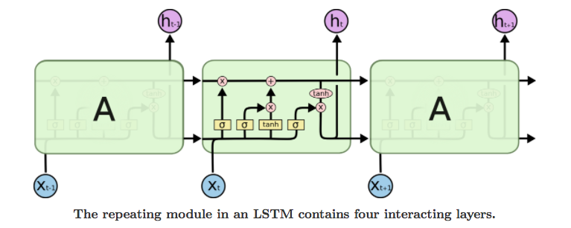
Long Short Term Memory

Slide 15
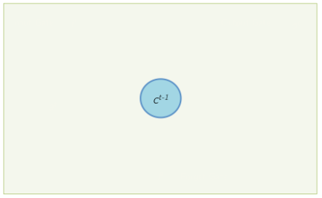

Slide 16
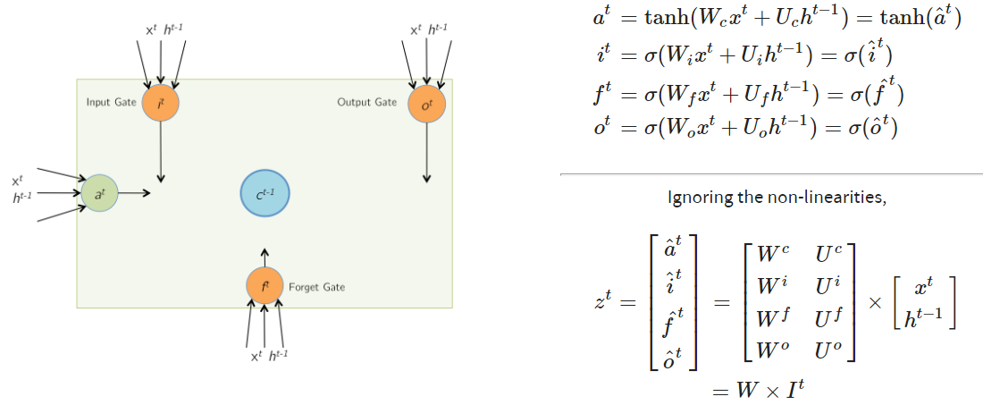

Slide 17
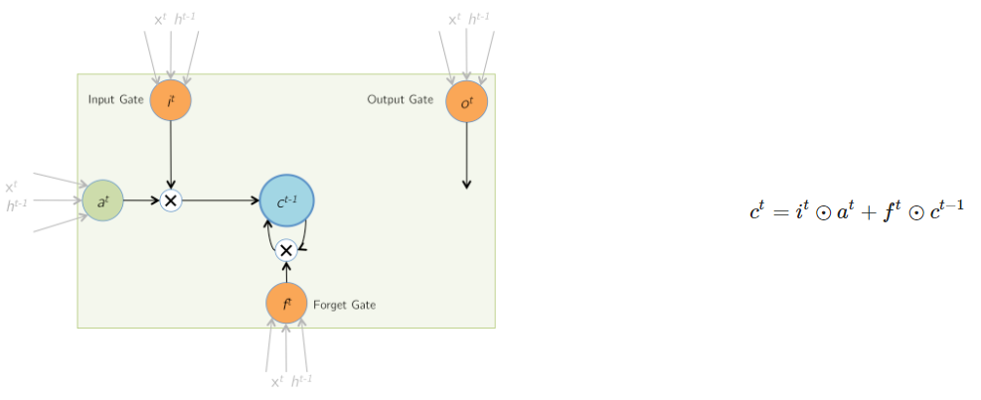

Slide 18
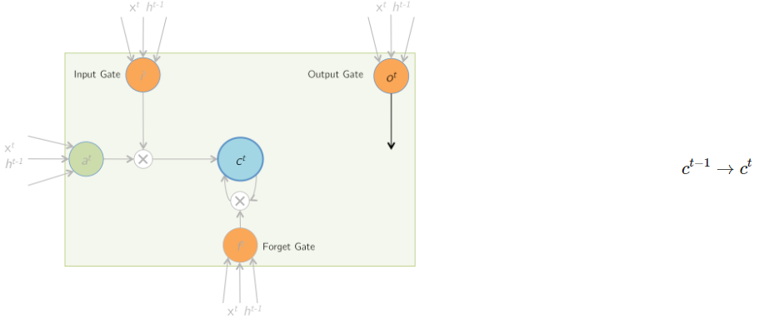

Slide 19
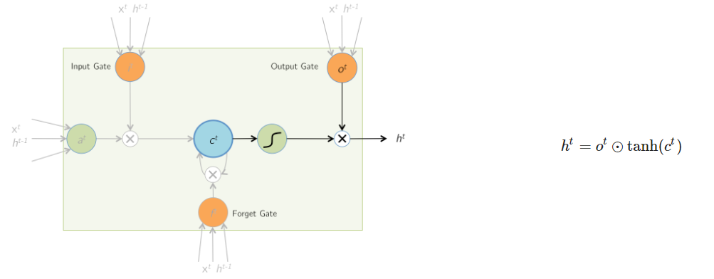

Slide 20
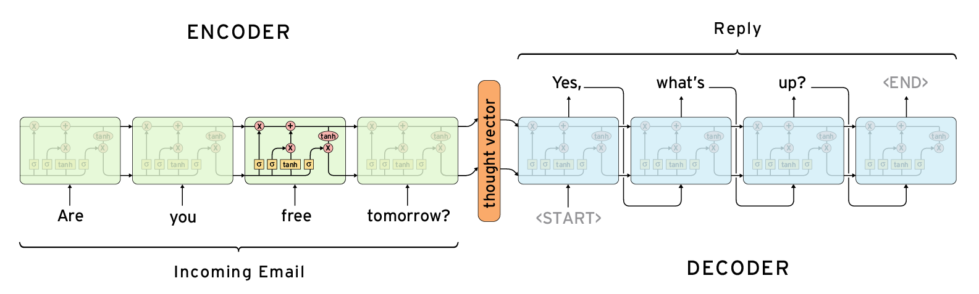
Seq2Seq

Slide 21
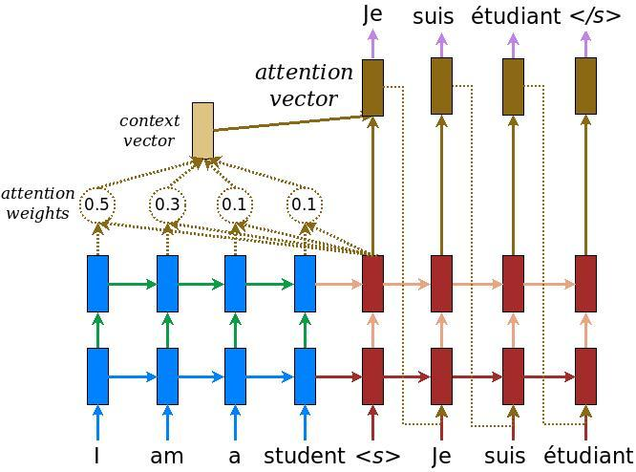
Attention Mechanism

Slide 22
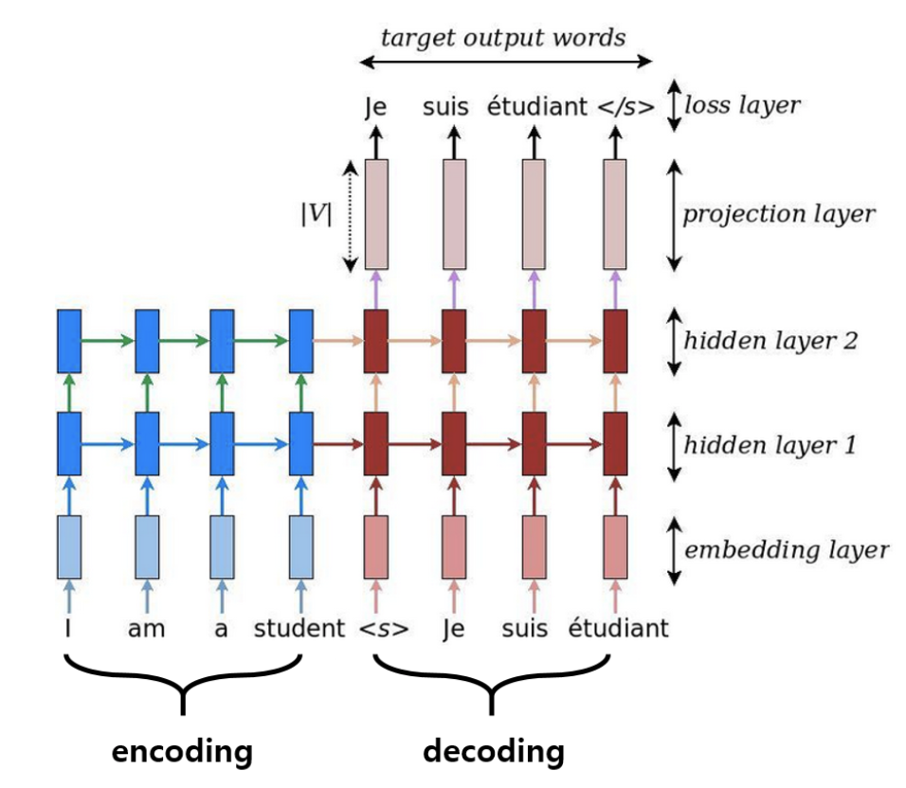
Final Model

Slide 23
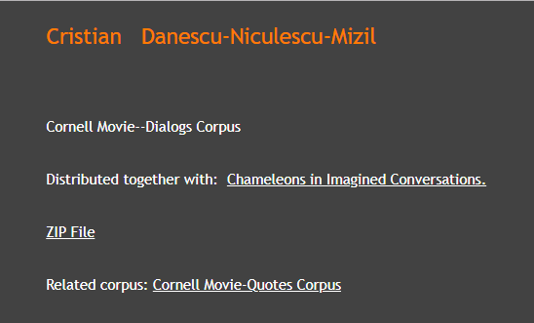
Dataset
Cornell Movie Dialogs Corpus
220,579 conversational exchanges between 10,292 pairs of movie characters. After filtering, used nearly 48,000 conversations. Contained more than 15,000 words.
Involves 9,035 characters from 617 movies.

